Slide 1



Tata Task 3
View in Power BI
Last data refresh:
10/9/2023 3:59:50 AM UTC
Downloaded at:
10/9/2023 6:16:22 AM UTC

Slide 2
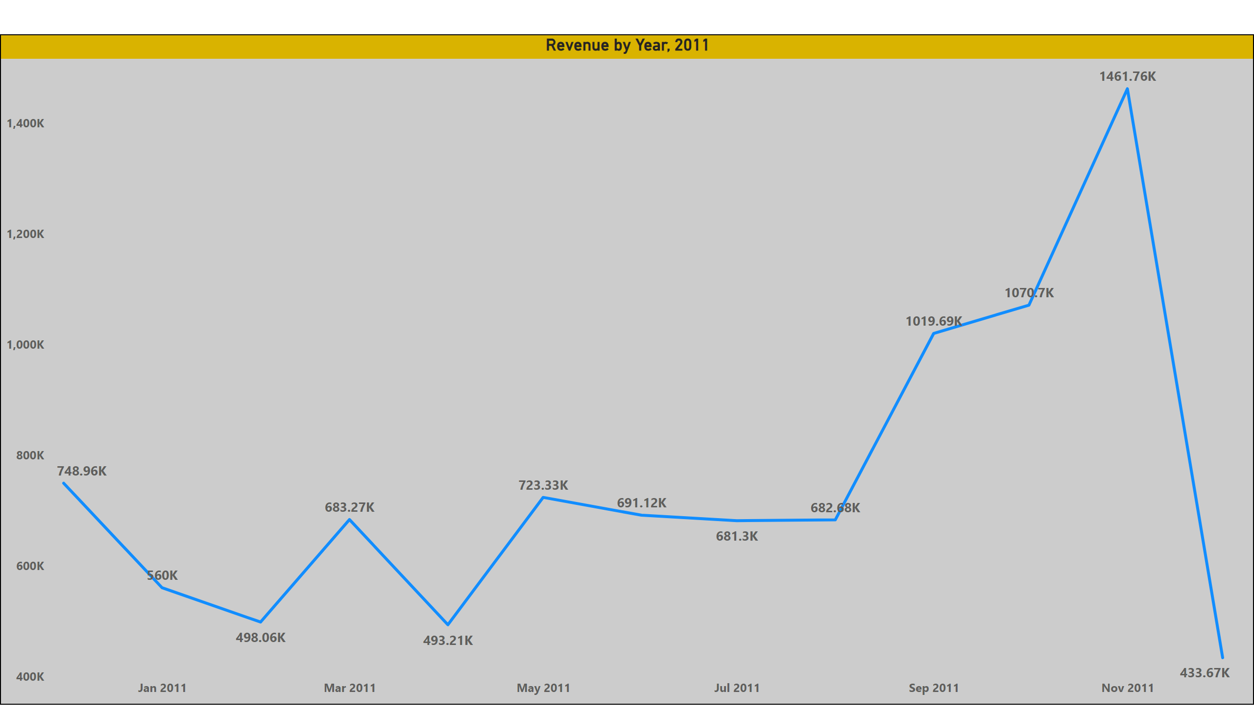
Question 1
Notes:
Revenue by Year, 2011
No alt text provided

Slide 3
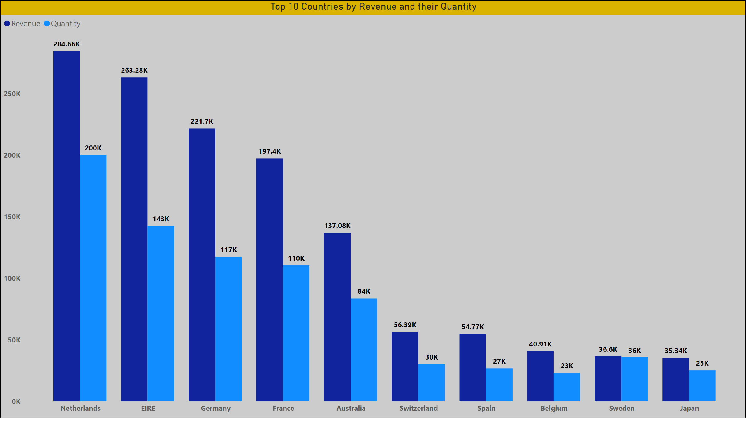
Question 2
Notes:
Top 10 Countries by Revenue and their Quantity
No alt text provided

Slide 4
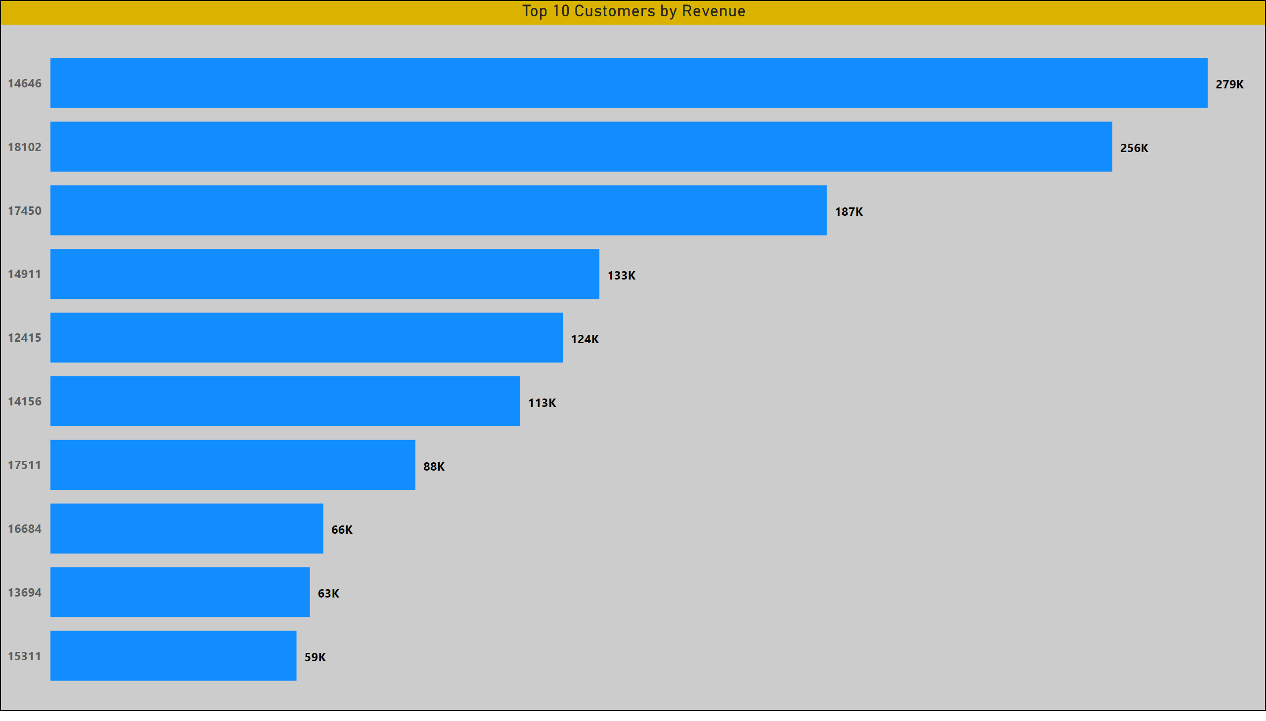
Question 3
Notes:
Top 10 Customers by Revenue
No alt text provided

Slide 5
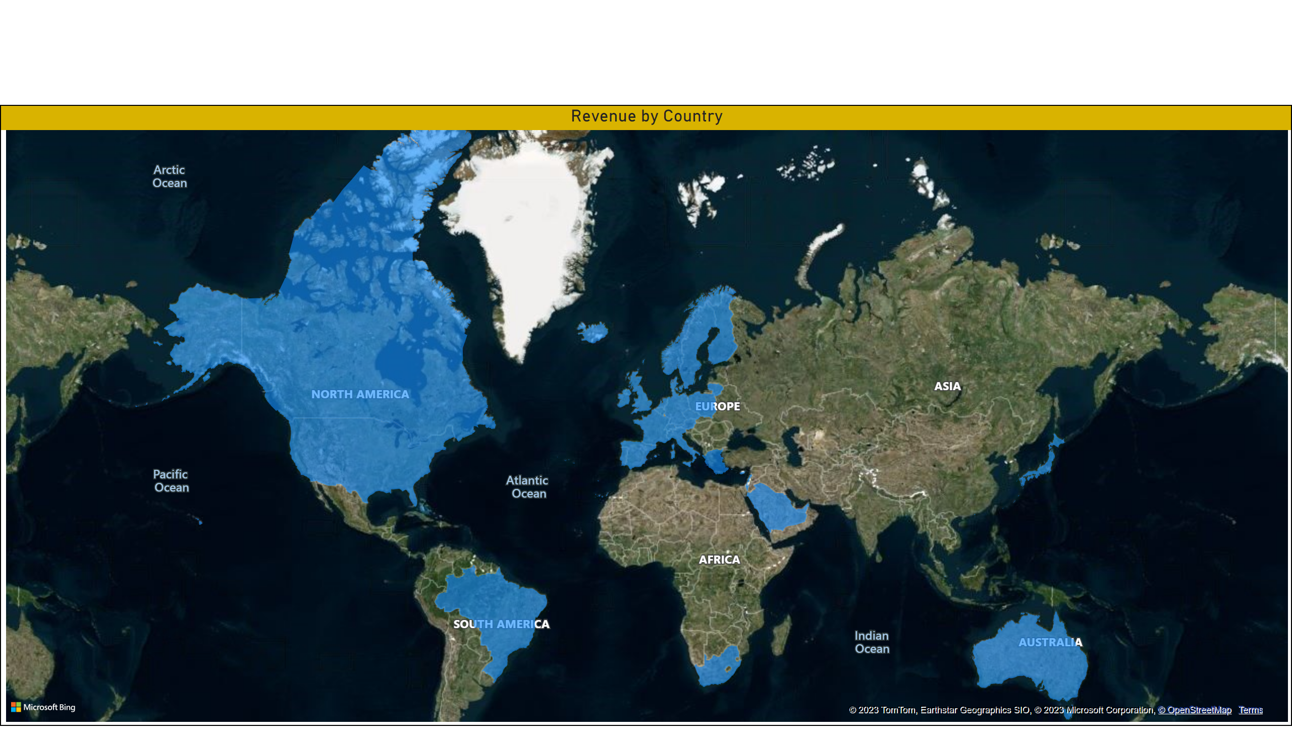
Question 4
Notes:
filledMap
No alt text provided

